Slide 1
6 - 1 Ethics in Games
Virtual Environment Design
Dr Patrick Merritt
p.merritt@derby.ac.uk

Slide 2
Warning!
In this session we will be broaching some possibly uncomfortable topics.
If you are uncomfortable with a topic, you may leave at any time.

Slide 3
Contents
Ethics in Games

Slide 4
Ethics in Games
Just because you can doesn’t mean you should…

Slide 5
What is ethics?
“Moral principles that govern a person's behaviour or the conducting of an activity.”
“Academic ethics are a set of principles addressing how researchers and research organisations should conduct themselves when dealing with research participants, their data or tissue, other researchers and colleagues, the users of their research and society in general.”
Ethics sets the standard of what is acceptable and what is not.
Ethics protect are there to protect you!

Slide 6
Format
The class will be presented with a topic.
One or more individuals will come up to the front and debate the topic.
I may take a side.
Don’t be offensive to each other.
Remember Rule Zero…
Respect each other’s opinions.

Slide 7


Mario or Sonic?

Slide 8


Salt and Vinegar or Cheese and Onion

Slide 9

Green or Blue?

Slide 10
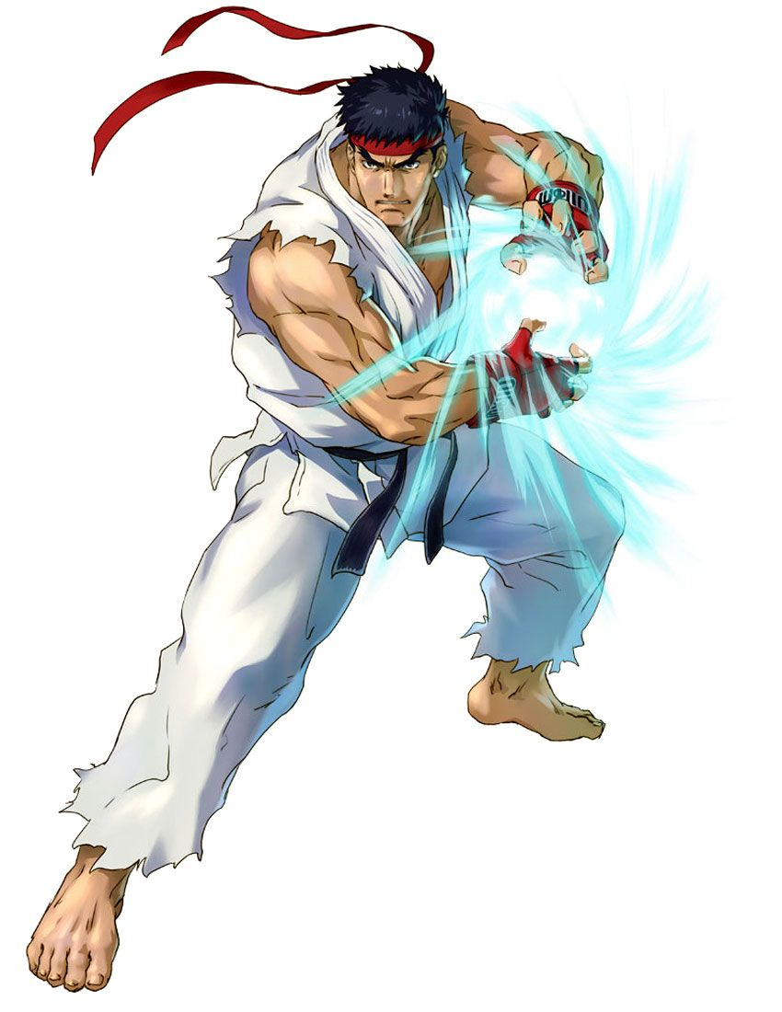

Fighting Games or Sports Games

Slide 11


Western RPG’s or JRPG’s

Slide 12


FPS or 3rd Person Shooters

Slide 13
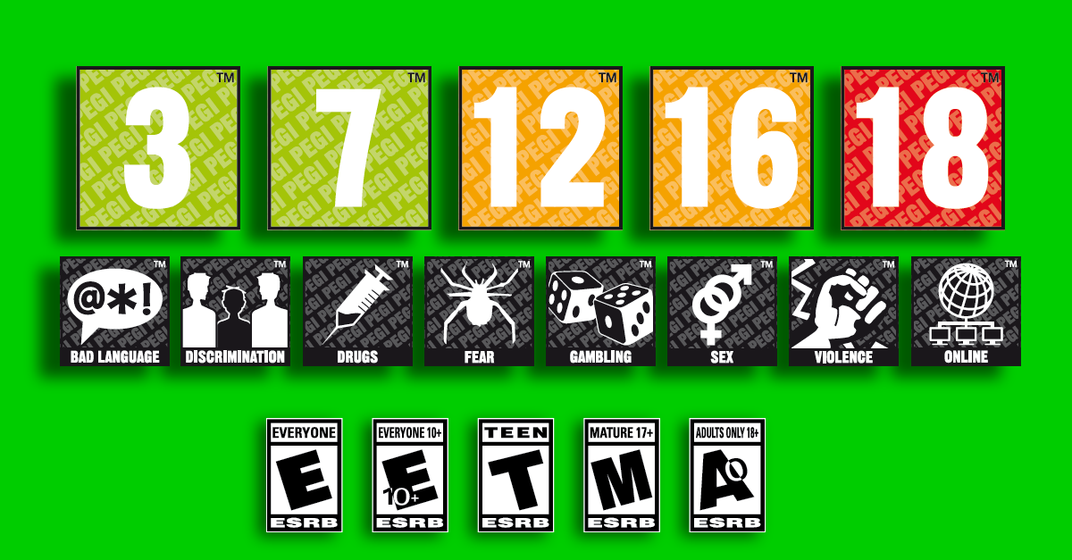
Age Ratings?

Slide 14

Violence in games

Slide 15
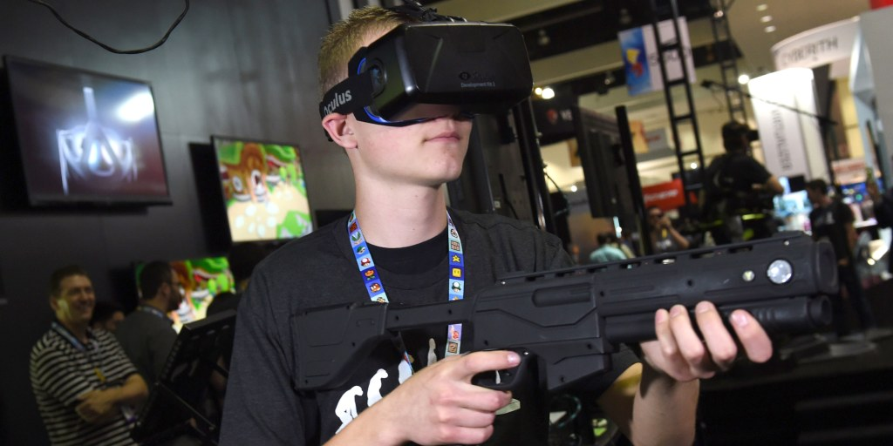
Violence in games

Slide 16
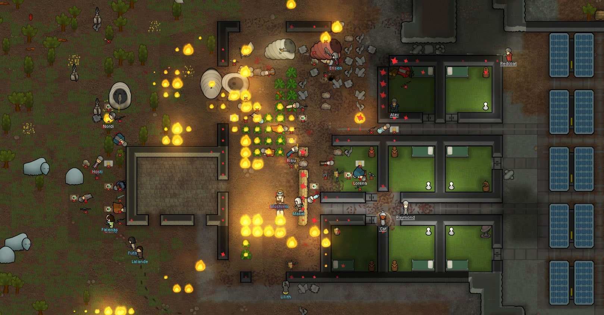
Rimworld?

Slide 17
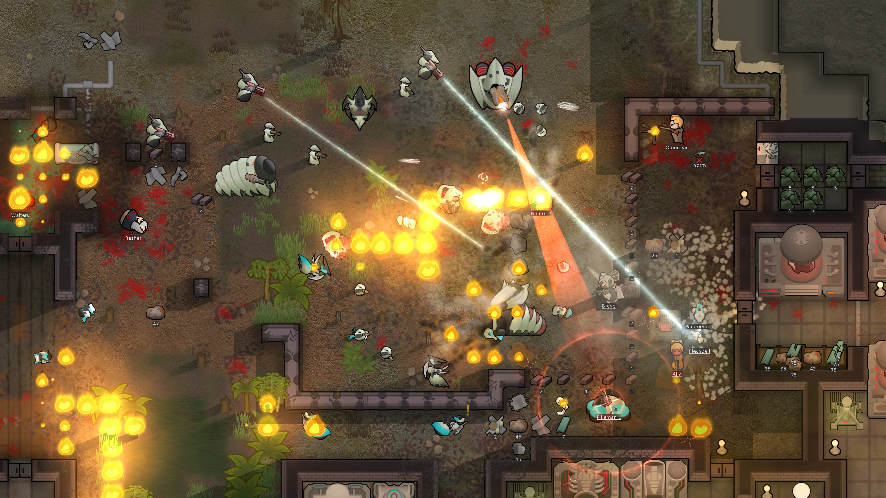
Rimworld?

Slide 18
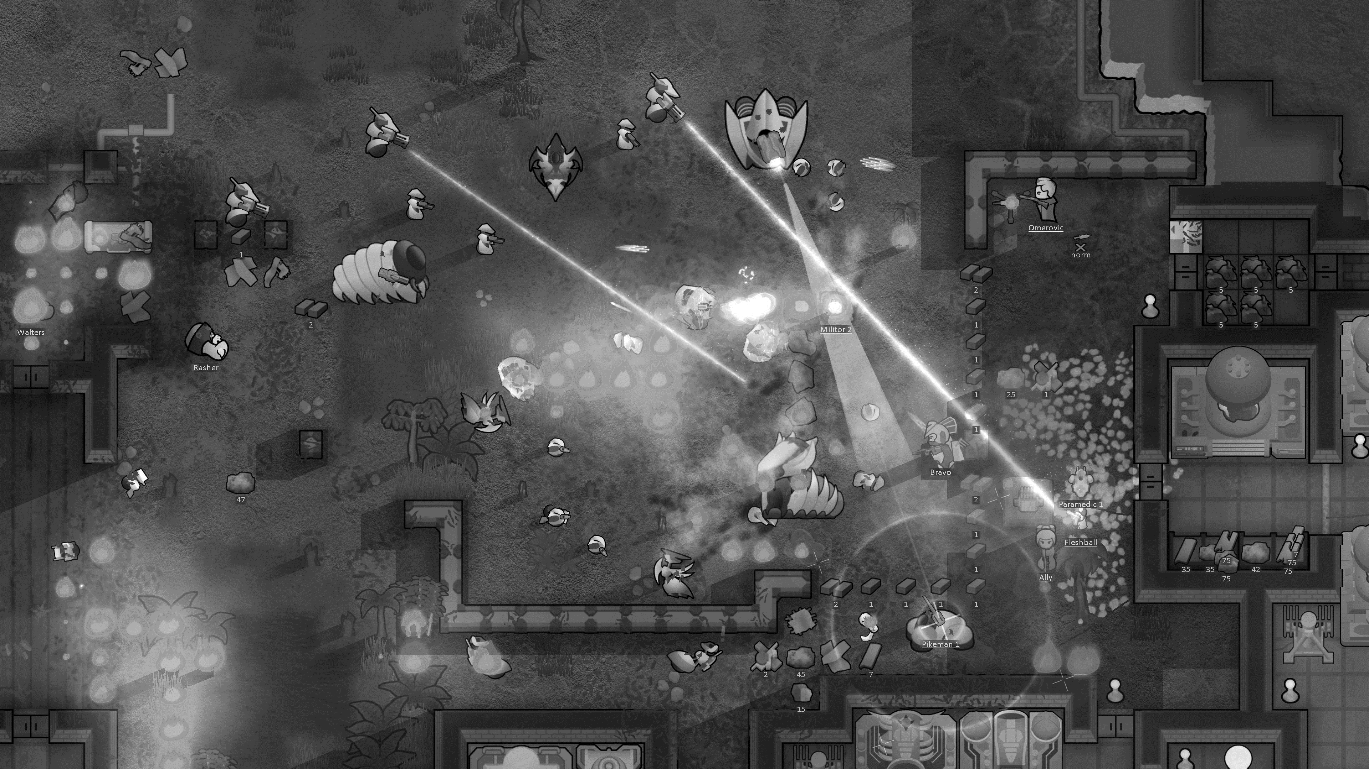

Slide 19

Mods

Slide 20
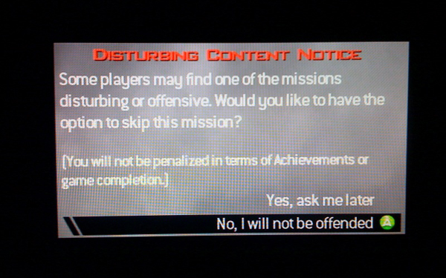
No Russian?
Trigger warning…
https://www.youtube.com/watch?v=8YRyriDQaoI

Slide 21


Heads or Tails?

Slide 22

Loot boxes?

Slide 23


Gender representation in games

Slide 24

Gender representation outside of games

Slide 25
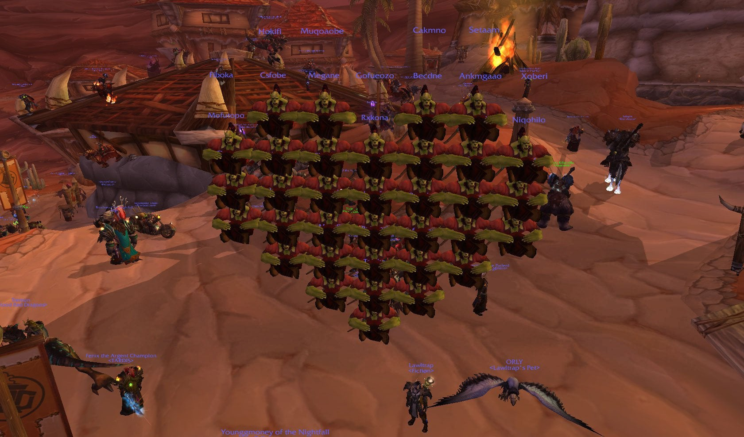
Hacking

Slide 26
The hardest question…
One volunteer to answer the hardest question in ALL of games.
Please not the question is not given out ahead of time as such this question is NOT included in the pre-release slides
:P

Slide 27
Why do you deserve a job in games?

Slide 28
Lab Session this week
I am expecting to see drafts of your presentations for next week…
You may want to do some rehearsals, and get some feedback.

